Slide 1


Facebook Data Science Project Exploratory Data Analysis
Data Diggers International Group Feb 28, 2017
Notes:
This template can be used as a starter file to give updates for project milestones.
Sections
Right-click on a slide to add sections. Sections can help to organize your slides or facilitate collaboration between multiple authors.
Notes
Use the Notes section for delivery notes or to provide additional details for the audience. View these notes in Presentation View during your presentation.
Keep in mind the font size (important for accessibility, visibility, videotaping, and online production)
Coordinated colors
Pay particular attention to the graphs, charts, and text boxes.
Consider that attendees will print in black and white or grayscale. Run a test print to make sure your colors work when printed in pure black and white and grayscale.
Graphics, tables, and graphs
Keep it simple: If possible, use consistent, non-distracting styles and colors.
Label all graphs and tables.

Slide 2

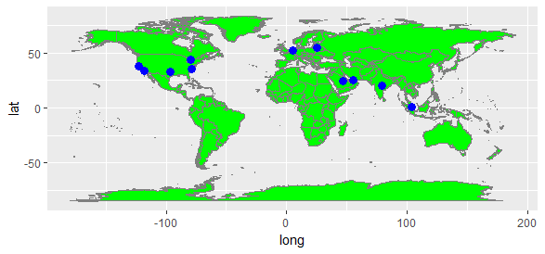
Team Info
Ali Qaiser Syed
Annada Prasad
Chia Aik Lee
Diego Jaramillo
Kiran Devathi
Manoj Kalamkar
Praveen Parvataneni
Subrata Roy
Ravi Shanker Rao Bodkai
Vasudev Pendyala
Notes:
What is the project about?
Define the goal of this project
Is it similar to projects in the past or is it a new effort?
Define the scope of this project
Is it an independent project or is it related to other projects?
* Note that this slide is not necessary for weekly status meetings

Slide 3

Domain
Social Network
Topic
Facebook Data Analysis
Notes:
What is the project about?
Define the goal of this project
Is it similar to projects in the past or is it a new effort?
Define the scope of this project
Is it an independent project or is it related to other projects?
* Note that this slide is not necessary for weekly status meetings

Slide 4

Introduction
Project
This project is to analyze and explore the Facebook Data using the EDA concepts with the application of Python programming language.
Objective
Prepare and present the project report with HYFY Google chrome extension.
Scope
Dataset containing pseudo Facebook data.
Notes:
What is the project about?
Define the goal of this project
Is it similar to projects in the past or is it a new effort?
Define the scope of this project
Is it an independent project or is it related to other projects?
* Note that this slide is not necessary for weekly status meetings

Slide 5
Dataset Description
Pseudo facebook data
Semi-structured, Multivariate data
Time-ordered data
Data Quality : Contains missing values
Number of Attributes : 15
The dataset contains polls of Facebook’s male and female users among the various age groups with Likes received and Friends request accepted over the web and mobile channels.
Source : Provided by Upx Academy for data science foundation project evaluation
Notes:
* If any of these issues caused a schedule delay or need to be discussed further, include details in next slide.

Slide 6
Dataset Info()
# of Records | 99,003
# of Columns | 15
Sl.No | Column Description | Data Type
1 | dob_year_dob_month_dob_day | datetime64[ns]
2 | userid | int64
3 | age | int64
4 | gender | object
5 | tenure | float64
6 | friend_count | int64
7 | friendships_initiated | int64
8 | likes | int64
9 | likes_received | int64
10 | mobile_likes | int64
11 | mobile_likes_received | int64
12 | www_likes | int64
13 | www_likes_received | int64
14 | tenure_mnth | float64
15 | tenure_yrs | float64
Notes:
Duplicate this slide as necessary if there is more than one issue.
This and related slides can be moved to the appendix or hidden if necessary.

Slide 7
Dataset Describe()
Columns | Count | Mean | std | Min | 25% | 50% | 75% | Max
age | 99003 | 37.28 | 22.59 | 13 | 20 | 28 | 50 | 113
tenure | 99001 | 537.89 | 457.65 | 0 | 226 | 412 | 675 | 3139
friend_count | 99003 | 196.35 | 387.30 | 0 | 31 | 82 | 206 | 4923
friendships_initiated | 99003 | 107.45 | 188.79 | 0 | 17 | 46 | 117 | 4144
likes | 99003 | 156.08 | 572.28 | 0 | 1 | 11 | 81 | 25111
likes_received | 99003 | 142.69 | 1387.92 | 0 | 1 | 8 | 59 | 261197
mobile_likes | 99003 | 106.12 | 445.25 | 0 | 0 | 4 | 46 | 25111
mobile_likes_received | 99003 | 84.12 | 839.89 | 0 | 0 | 4 | 33 | 138561
www_likes | 99003 | 49.96 | 285.56 | 0 | 0 | 0 | 7 | 14865
www_likes_received | 99003 | 58.57 | 601.42 | 0 | 0 | 2 | 20 | 129953
tenure_mnth | 99001 | 1.47 | 1.25 | 0 | 0.62 | 1.13 | 1.85 | 8.6
Notes:
Duplicate this slide as necessary if there is more than one issue.
This and related slides can be moved to the appendix or hidden if necessary.

Slide 8
EDA – Visualization Importance
Graph representation conveys information in more effective and efficient way than pure text description.
Graphs representations are expressive and conveys information in a detailed way.
Analysts can identify outliers, trend and patterns hidden in data by using appropriate visualization techniques.
Spotting outliers – ex: Box Plots
Discriminating clusters – ex: Scatter Plots
Examining relationships – ex: Correlation Plots
Comparing mean differences – ex: Cell-mean Plots
Observing a time based process – ex: Line Plots
Checking distributions – ex: Probability Plots
Notes:
Duplicate this slide as necessary if there is more than one issue.
This and related slides can be moved to the appendix or hidden if necessary.

Slide 9
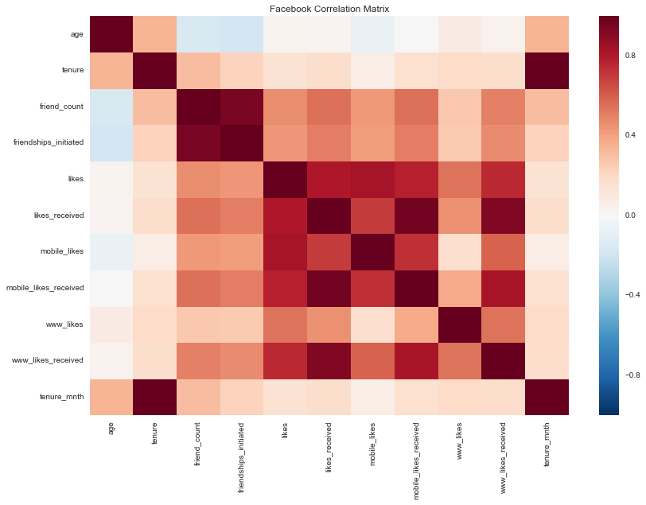
Dataset Correlation
positive co-relation between friend count & friendships initiated
positive correlation for various likes received / given with total number of likes
friend count /friendships initiated is in near to negative correlation with age
etc..
Notes:
Duplicate this slide as necessary if there is more than one issue.
This and related slides can be moved to the appendix or hidden if necessary.

Slide 10
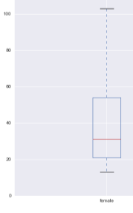
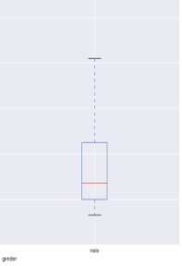
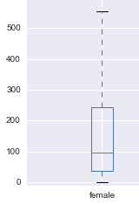
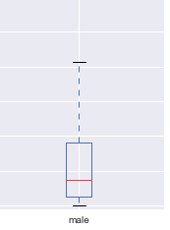
Box Plots
100
80
60
40
20
0
From the Age analysis it is observed that average female age is more than male age.
Also can observe that female users have wider age range than the male users.
Age
Female Male
From the Average Friend Count analysis it is observed that females have more friends than males.
Also can observe that females have wider friend count range than the males.
Friend Count
Female Male
Notes:
Duplicate this slide as necessary if there is more than one issue.
This and related slides can be moved to the appendix or hidden if necessary.

Slide 11
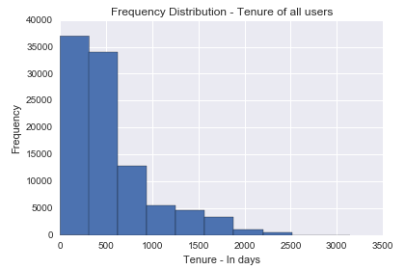
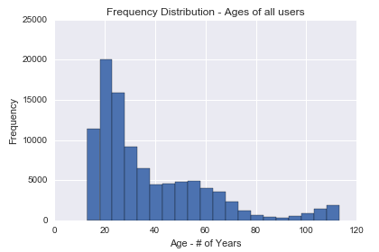
Frequency Polygons
Facebook users Tenure frequency analysis shows that majority of users joined Facebook in last couple of years (~77%).
This could be attributed to technological transformation and Mobile First strategy where more and more users are using Mobile and hence Facebook is easily accessible.
Facebook users Age frequency analysis shows that majority of users are of early 20’s age and as the age grows the frequency is declining.
Quite surprisingly frequency was increasing after 90 which raises sanctity of data for 90+ aged users. Further analysis is required to conclude that.

Slide 12
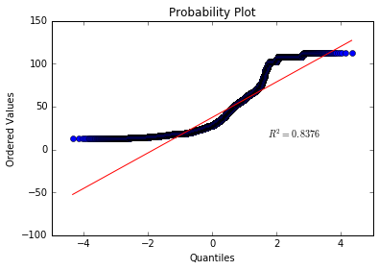
Normal Probability Plot
Age pattern analysis of Facebook users
It shows that the age is not normally distributed. However, the normal distribution here has a high R-square in the mid-section.

Slide 13
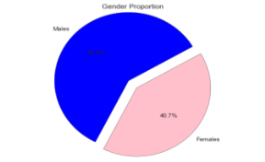
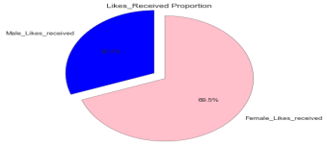
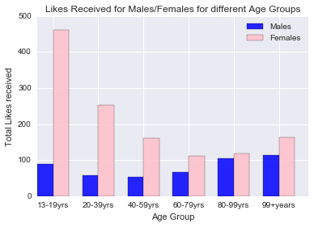
Business Question
Does Gender and Age of users effect their likeability in Facebook?
Approach
Pie distributions of male and female gender and likes received among the genders.
Bar Graph of Average likes received for male and females in various age groups.
Findings & Visualizations
Even though males are 19% higher in number than females, the likes received by females are more than double that of males.
Female teens got likes more than 4 times that of male teens.
In 20-39 age group also females got almost 5 times more likes than males.
Notes:
Duplicate this slide as necessary if there is more than one issue.
This and related slides can be moved to the appendix or hidden if necessary.

Slide 14
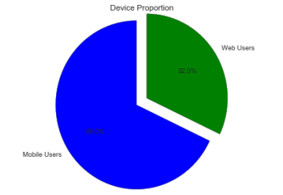
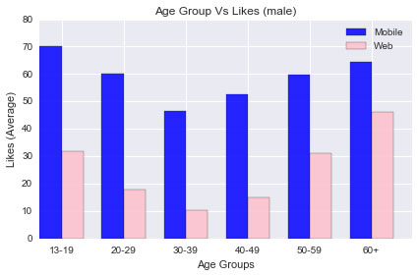
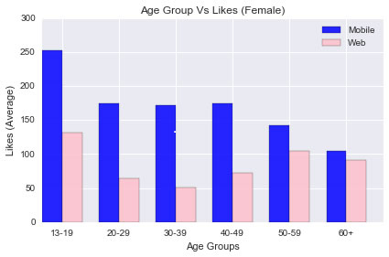
Business Question
How is Facebook mostly accessed by its users and from where? Mobile or Web?
Approach
Pie distribution of Mobile and Web users accessing Facebook.
Bar Graphs of male & female users accessing Facebook on Mobile & Web channels among various age groups.
Findings & Visualizations
From the Pie distribution, it is observed that users access Facebook mostly from Mobile than Web channel.
Bar Graphs also conclude that users access Facebook largely from Mobile than Web channel across all the age groups.
Notes:
Duplicate this slide as necessary if there is more than one issue.
This and related slides can be moved to the appendix or hidden if necessary.

Slide 15
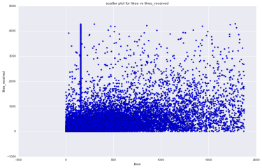
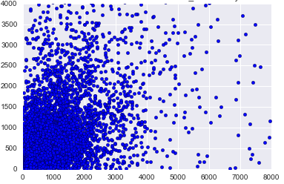
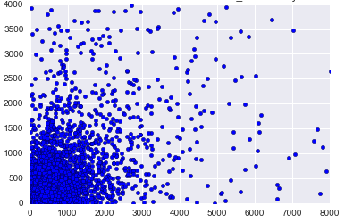
Business Question
How are Likes and Likes Received related for the Facebook users?
Approach
Scatter plots for the entire sample.
Scatter plots for Likes v/s Likes Received among male gender & female gender.
Females
Findings & Visualizations
Liking More does not mean an individual be Liked Back more.
From the gender plots it is observed that females receive likes more than they give likes.
Likes Received
Likes
Males
Likes Received
Likes
Notes:
Duplicate this slide as necessary if there is more than one issue.
This and related slides can be moved to the appendix or hidden if necessary.

Slide 16
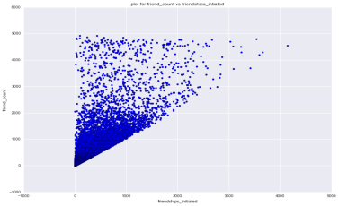
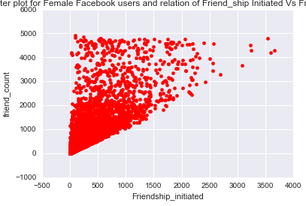
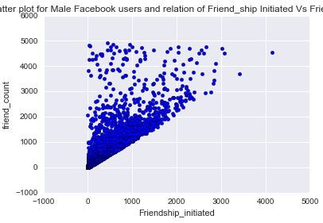
Business Question
How are Friend Count and Friendship Initiated related for the Facebook users?
Approach
Scatter plots for the entire sample.
Scatter plots for Friend Count v/s Friendship Initiated among male gender & female gender.
Females
Findings & Visualizations
Most users have more Friends than Friendship Initiated.
From the gender plots it is observed that females users get far more Friend requests than Friendship Initiated.
Males
Notes:
Duplicate this slide as necessary if there is more than one issue.
This and related slides can be moved to the appendix or hidden if necessary.

Slide 17
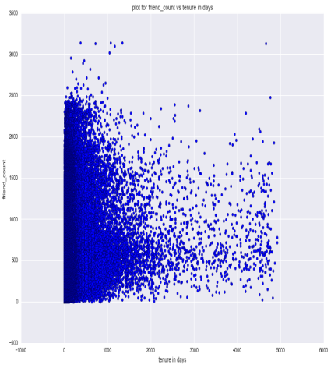
Business Question
How does friend count relate to users as they continue to stay long tenure on Facebook?
Approach
Scatter plot for the entire sample.
Scatter plot for Friend Count v/s Tenure among the Facebook users.
Findings & Visualizations
Longer tenure on Facebook does not translate to more friends.
Friend count rate is decreasing over time for the users.
Notes:
Duplicate this slide as necessary if there is more than one issue.
This and related slides can be moved to the appendix or hidden if necessary.

Slide 18
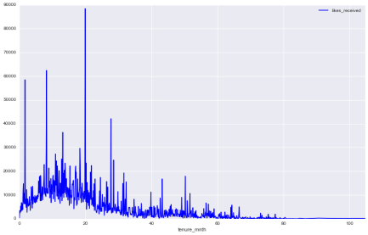
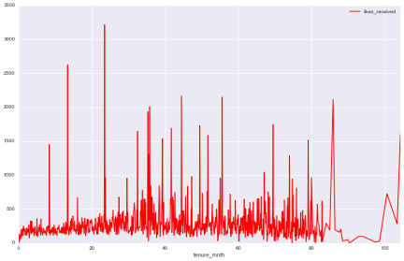
Business Question
Males
How does likes received relate to users as they continue to stay long tenure on Facebook?
Approach
Line Graph Distribution for the entire sample.
Line Graph for Likes Received v/s Tenure (in months) among the Facebook users.
Findings & Visualizations
Likes Received for male users goes down past the 60 months tenure and keeps diminishing even more.
Likes Received for female users remained uniform up until 85 months and even beyond spikes were observed.
Females
Notes:
Duplicate this slide as necessary if there is more than one issue.
This and related slides can be moved to the appendix or hidden if necessary.

Slide 19
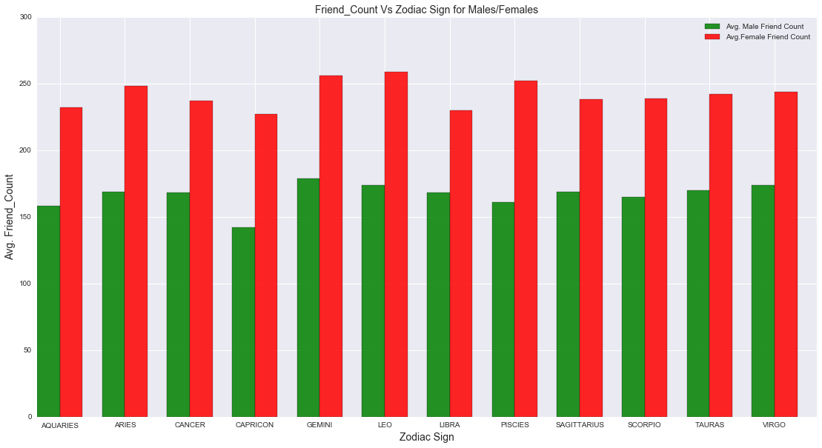
Business Question
How does Zodiac Signs impact users with their social likability?
Approach
Bar Graphs for the entire sample.
Bar Graphs for Friend Count v/s Zodiac Sign among the Facebook users.
Findings & Visualizations
Friend Count (social likability) seems to be uniform among various Zodiac Signs between the male and female users on the Facebook.
Notes:
Duplicate this slide as necessary if there is more than one issue.
This and related slides can be moved to the appendix or hidden if necessary.

Slide 20
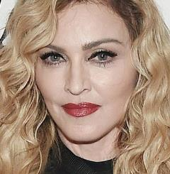
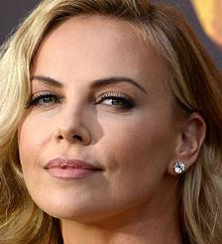

Inferential Question?
Guess why these Hollywood Stars are so popular on Social Media?
Notes:
Duplicate this slide as necessary if there is more than one issue.
This and related slides can be moved to the appendix or hidden if necessary.

Slide 21
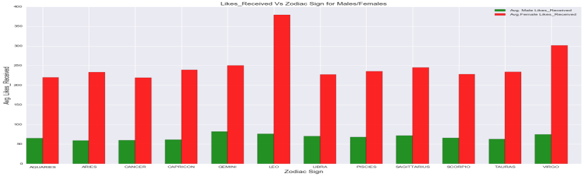
Inference
Leo Females are more popular followed by Virgo and others.
Notes:
Duplicate this slide as necessary if there is more than one issue.
This and related slides can be moved to the appendix or hidden if necessary.

Slide 22
Thank You
Data is the new oil
&
Analytics is the combustion engine

